Slide 1
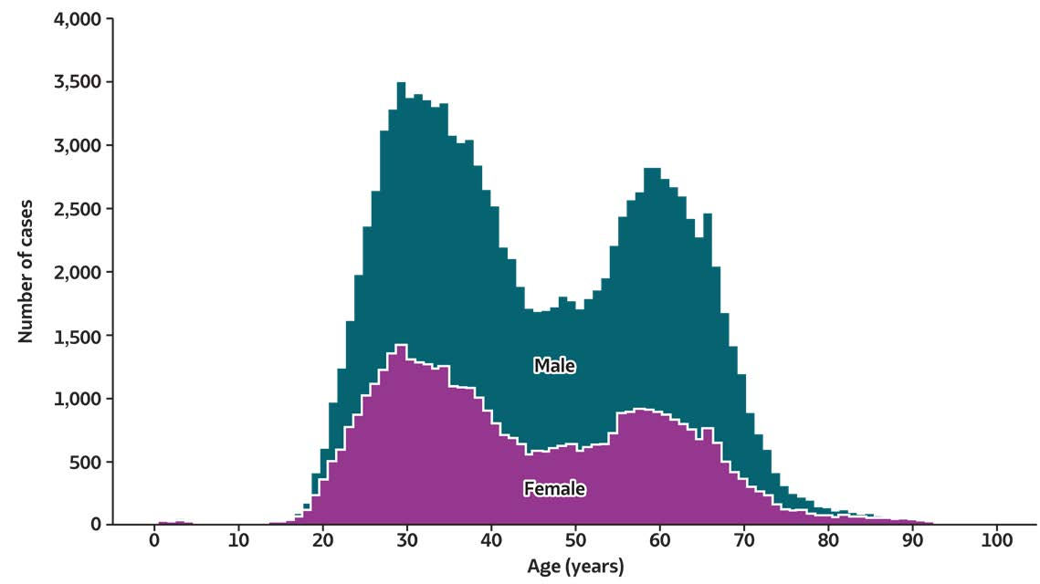
2019 VIRAL HEPATITIS
SURVEILLANCE REPORT
Figure 3.8. Number of newly reported* chronic hepatitis C virus infection cases†, by sex and age — United States, 2019
Source: CDC, National Notifiable Diseases Surveillance System.
* During 2019, cases of chronic hepatitis C were either not reportable by law, statute, or regulation; not reported; or otherwise unavailable to CDC from Arizona, Arkansas, California, Delaware, District of Columbia, Hawaii, Indiana, Kentucky, Mississippi, Nevada, North Carolina, Rhode Island, and Texas.
† Only confirmed, newly reported, chronic hepatitis C cases are included. For the complete case definition, see https://ndc.services.cdc.gov/conditions/hepatitis-c-chronic/.

