Slide 1

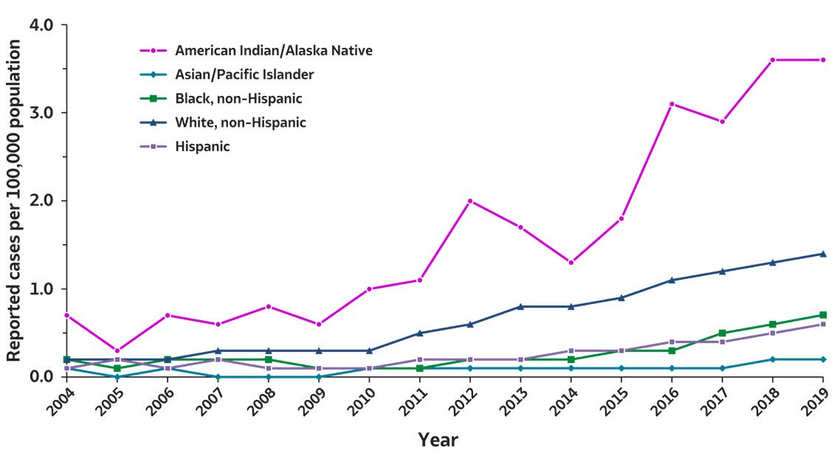
2019 VIRAL HEPATITIS
SURVEILLANCE REPORT
Figure 3.6. Rates of reported acute hepatitis C virus infection, by race/ ethnicity — United States, 2004–2019
Race/Ethnicity | 2004 | 2005 | 2006 | 2007 | 2008 | 2009 | 2010 | 2011 | 2012 | 2013 | 2014 | 2015 | 2016 | 2017 | 2018 | 2019
American Indian/ Alaska Native | 0.7 | 0.3 | 0.7 | 0.6 | 0.8 | 0.6 | 1.0 | 1.1 | 2.0 | 1.7 | 1.3 | 1.8 | 3.1 | 2.9 | 3.6 | 3.6
Asian/ Pacific Islander | 0.1 | 0.0 | 0.1 | 0.0 | 0.0 | 0.0 | 0.1 | 0.1 | 0.1 | 0.1 | 0.1 | 0.1 | 0.1 | 0.1 | 0.1 | 0.2
Black, non-Hispanic | 0.2 | 0.1 | 0.2 | 0.2 | 0.2 | 0.1 | 0.1 | 0.1 | 0.1 | 0.2 | 0.2 | 0.3 | 0.3 | 0.5 | 0.6 | 0.7
White, non-Hispanic | 0.2 | 0.2 | 0.2 | 0.2 | 0.3 | 0.3 | 0.3 | 0.5 | 0.6 | 0.8 | 0.8 | 0.9 | 1.1 | 1.2 | 1.3 | 1.4
Hispanic | 0.1 | 0.2 | 0.1 | 0.1 | 0.1 | 0.1 | 0.1 | 0.2 | 0.2 | 0.2 | 0.2 | 0.3 | 0.3 | 0.4 | 0.5 | 0.6
Source: CDC, National Notifiable Diseases Surveillance System.

