Slide 1
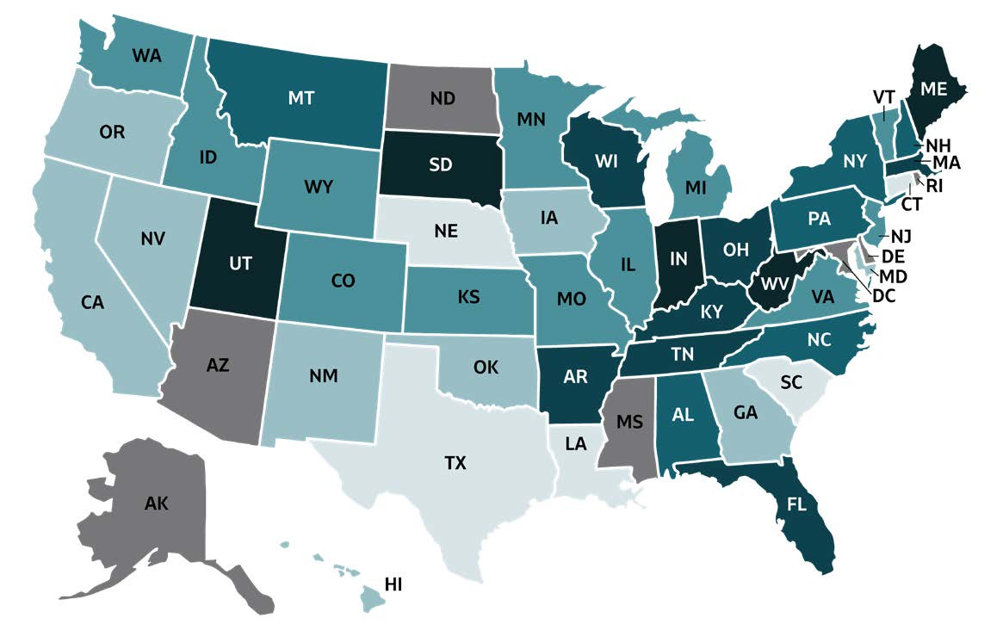
2019 VIRAL HEPATITIS
SURVEILLANCE REPORT
Figure 3.3. Rates of reported acute hepatitis C virus infection, by state or jurisdiction — United States, 2019
Color Key | Cases/100,000 Population | State or Jurisdiction
 | 0.0-0.2 | CT, LA, NE, SC, TX
 | 0.3-0.6 | CA, GA, HI, IA, MD, NM, NV, OK, OR
 | 0.7-1.2 | CO, ID, IL, KS, MI, MN, MO, NJ, VA, VT, WA, WY
 | 1.3-1.8 | AL, MT, NC, NH, NY, PA
 | 1.9-3.0 | AR, FL, KY, MA, OH, TN, WI
 | 3.1-4.8 | IN, ME, SD, UT, WV
 | Data not available | AK, AZ, DC, DE, MS, ND,RI
Source: CDC, National Notifiable Diseases Surveillance System.

