Slide 1
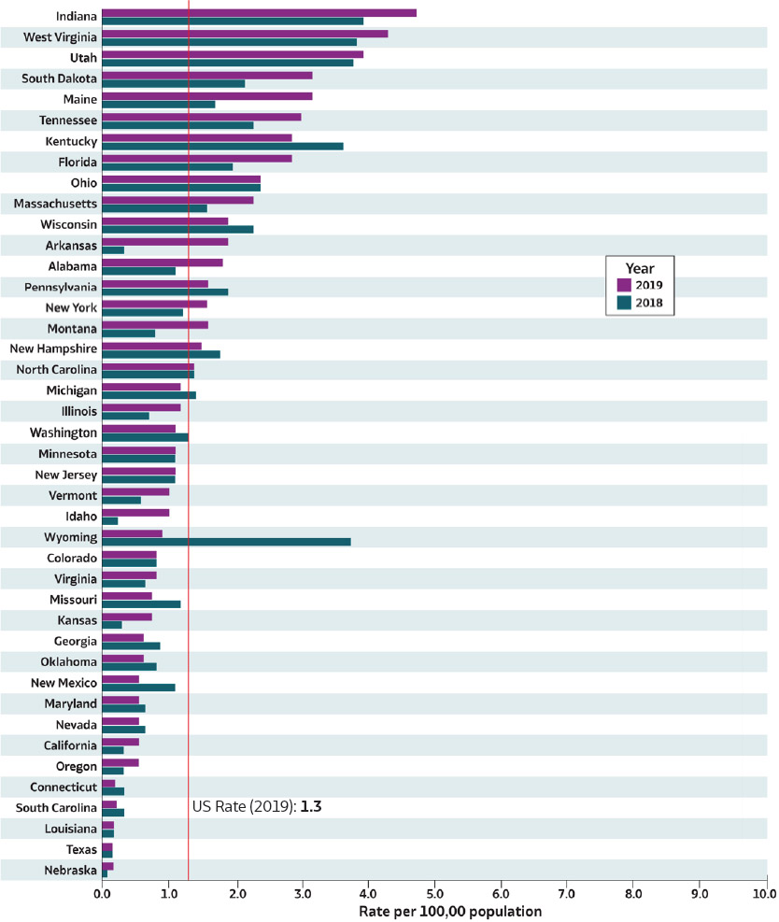
2019 VIRAL HEPATITIS
SURVEILLANCE REPORT
Figure 3.2. Rates* of reported acute hepatitis C† virus infections, by state — United States, 2018–2019
Source: CDC, National Notifiable Diseases Surveillance System.
* Rates per 100,000 population.
† Reported cases that met the classification criteria for a confirmed case. For the case definition, see https://ndc.services.cdc.gov/ conditions/hepatitis-c-acute/.
Only states with rates for 2018 and 2019 are shown. State/jurisdiction and year for no reported cases: North Dakota (2019), Hawaii (2018); for not reportable condition; Alaska (2018, 2019);
for unavailable data: Arizona (2018, 2019), Delaware (2018, 2019), District of Columbia
(2018, 2019), Iowa (2018, 2019),Mississippi (2018, 2019), Rhode Island (2018, 2019).

