Slide 1

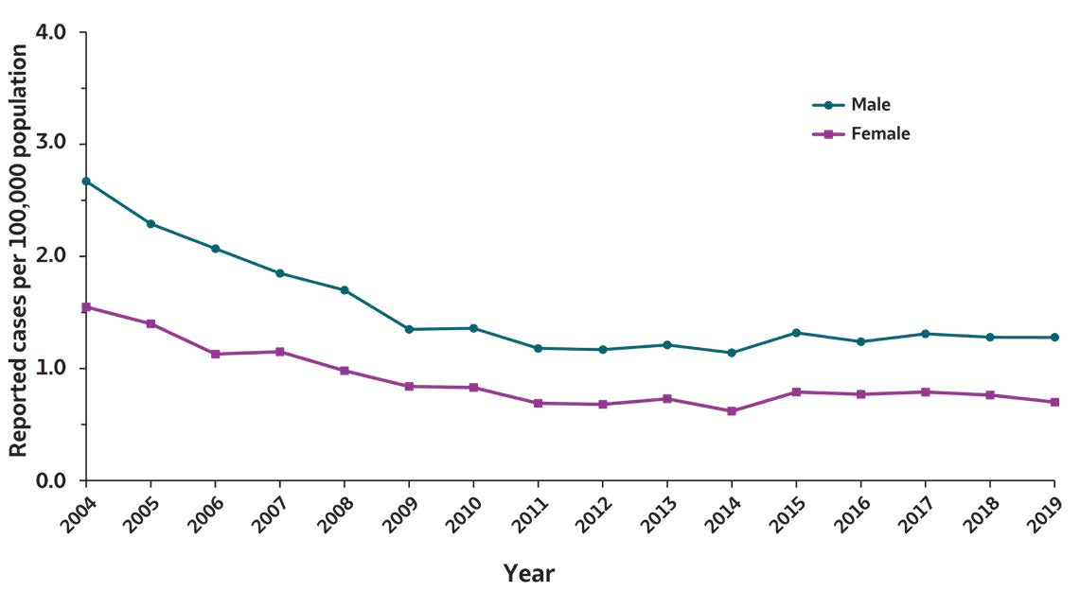
2019 VIRAL HEPATITIS
SURVEILLANCE REPORT
Figure 2.5. Rates of reported acute hepatitis B virus infection, by sex — United States, 2004–2019
Sex | 2004 | 2005 | 2006 | 2007 | 2008 | 2009 | 2010 | 2011 | 2012 | 2013 | 2014 | 2015 | 2016 | 2017 | 2018 | 2019
Male | 2.7 | 2.3 | 2.1 | 1.9 | 1.7 | 1.4 | 1.4 | 1.2 | 1.2 | 1.2 | 1.1 | 1.3 | 1.2 | 1.3 | 1.3 | 1.3
Female | 1.5 | 1.4 | 1.1 | 1.1 | 1.0 | 0.8 | 0.8 | 0.7 | 0.7 | 0.7 | 0.6 | 0.8 | 0.8 | 0.8 | 0.8 | 0.7
Source: CDC, National Notifiable Diseases Surveillance System.

