Slide 1
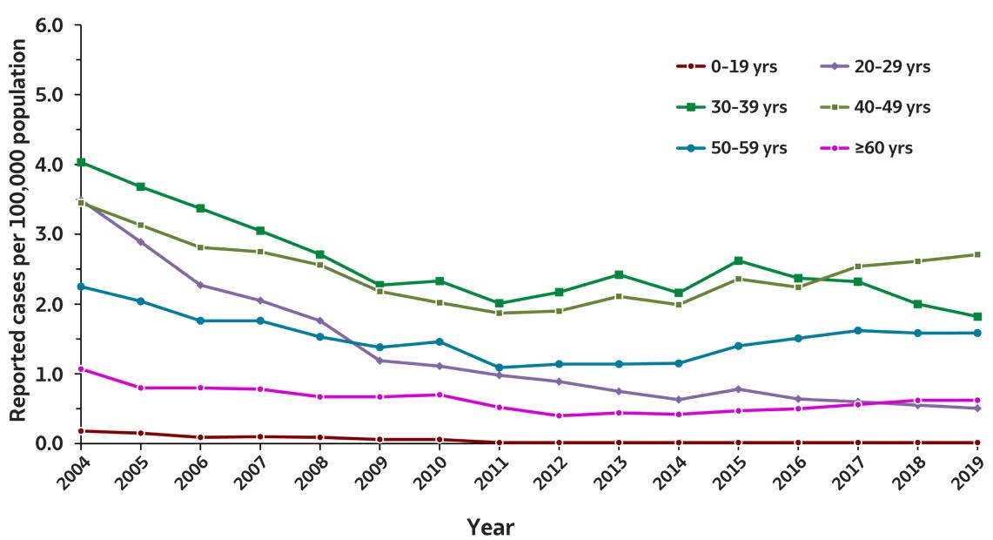
2019 VIRAL HEPATITIS
SURVEILLANCE REPORT
Figure 2.4. Rates of reported acute hepatitis B virus infection, by age group
— United States, 2004–2019
Age (years) | 2004 | 2005 | 2006 | 2007 | 2008 | 2009 | 2010 | 2011 | 2012 | 2013 | 2014 | 2015 | 2016 | 2017 | 2018 | 2019
0–19 | 0.2 | 0.2 | 0.1 | 0.1 | 0.1 | 0.1 | 0.1 | 0 | 0 | 0 | 0 | 0 | 0 | 0 | 0 | 0
20–29 | 3.5 | 2.9 | 2.3 | 2.0 | 1.8 | 1.2 | 1.1 | 1.0 | 0.9 | 0.8 | 0.6 | 0.8 | 0.6 | 0.6 | 0.6 | 0.5
30–39 | 4.0 | 3.7 | 3.4 | 3.0 | 2.7 | 2.3 | 2.3 | 2.0 | 2.2 | 2.4 | 2.2 | 2.6 | 2.4 | 2.3 | 2.0 | 1.8
40–49 | 3.4 | 3.1 | 2.8 | 2.7 | 2.6 | 2.2 | 2.0 | 1.9 | 1.9 | 2.1 | 2.0 | 2.4 | 2.2 | 2.5 | 2.6 | 2.7
50–59 | 2.3 | 2.0 | 1.8 | 1.8 | 1.5 | 1.4 | 1.5 | 1.1 | 1.1 | 1.1 | 1.2 | 1.4 | 1.5 | 1.6 | 1.6 | 1.6
≥60 | 1.1 | 0.8 | 0.8 | 0.8 | 0.7 | 0.7 | 0.7 | 0.5 | 0.4 | 0.4 | 0.4 | 0.5 | 0.5 | 0.6 | 0.6 | 0.6
Source: CDC, National Notifiable Diseases Surveillance System.

