Slide 1

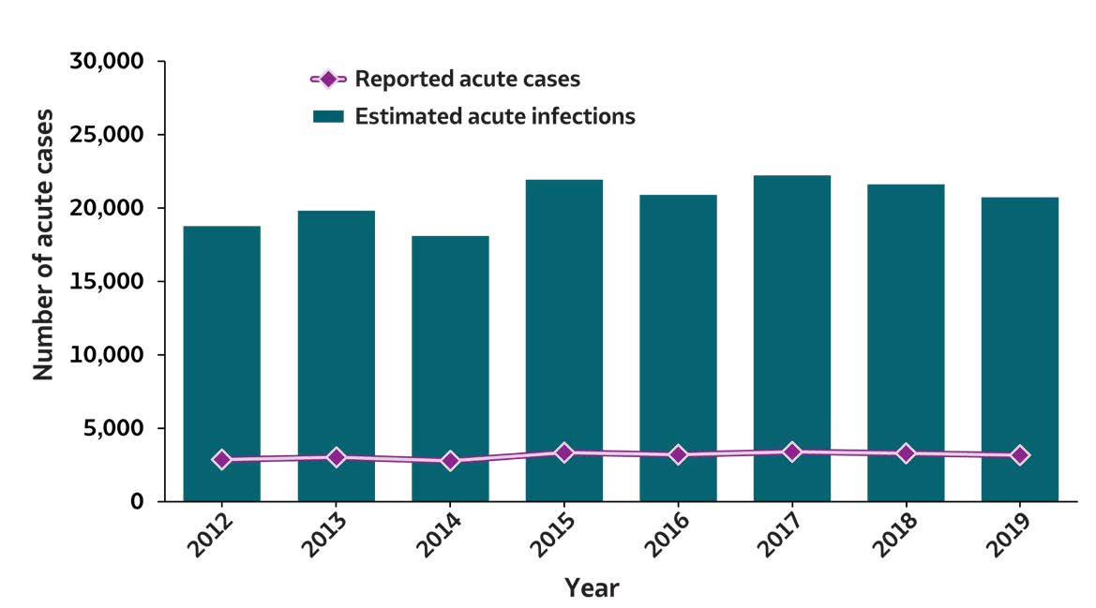
2019 VIRAL HEPATITIS
SURVEILLANCE REPORT
Figure 2.1. Number of reported acute hepatitis B virus infection cases and estimated infections* — United States, 2012–2019
Acute Hepatitis B | 2012 | 2013 | 2014 | 2015 | 2016 | 2017 | 2018 | 2019
Reported acute cases | 2,895 | 3,050 | 2,791 | 3,370 | 3,218 | 3,409 | 3,322 | 3,192
Estimated acute infections | 18,800 | 19,800 | 18,100 | 21,900 | 20,900 | 22,200 | 21,600 | 20,700
Source: CDC, National Notifiable Diseases Surveillance System.
* The number of estimated viral hepatitis infections was determined by multiplying the number of reported cases that met the classification criteria for a confirmed case by a factor that adjusted for underascertainment and underreporting. The 95% bootstrap confidence intervals for the estimated number of infections are displayed in the Appendix.

