Slide 1

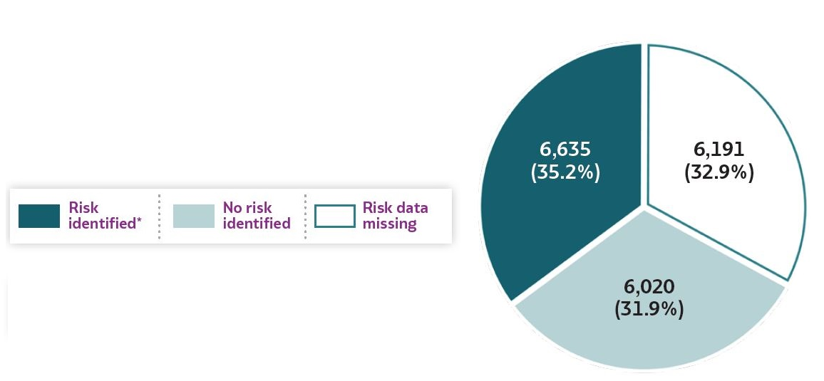
2019 VIRAL HEPATITIS
SURVEILLANCE REPORT
Figure 1.7. Availability of information regarding risk behaviors or exposures*† associated with reported cases of hepatitis A virus infection — United States, 2019
Source: CDC, Nationally Notifiable Diseases Surveillance System.
* Case reports with at least one of the following risk behaviors/exposures reported 2–6 weeks prior to symptom onset or documented seroconversion if asymptomatic: 1) injection drug use; 2) sexual, household, or other contact; 3) men who have sex with men; 4) travel to hepatitis A-endemic region.
† Reported cases may include more than one risk behavior/exposure.

