Slide 1
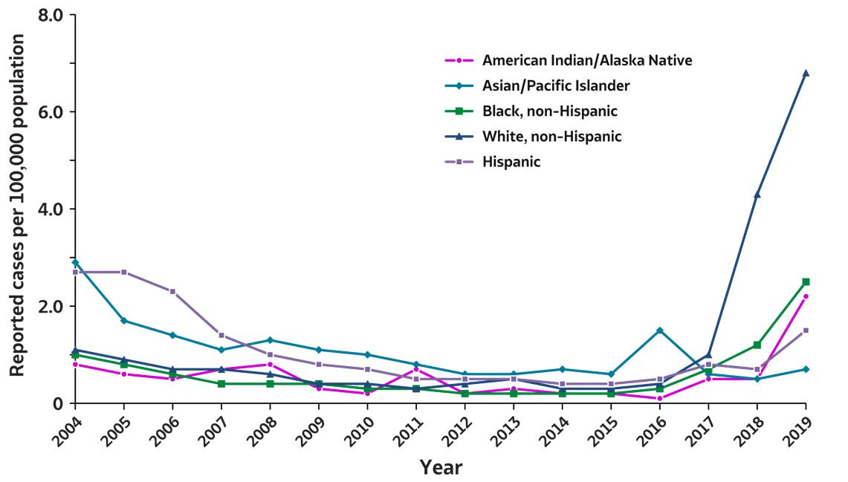
2019 VIRAL HEPATITIS
SURVEILLANCE REPORT
Figure 1.6. Rates of reported hepatitis A virus infection, by race/ethnicity — United States, 2004–2019
Race/ Ethnicity | 2004 | 2005 | 2006 | 2007 | 2008 | 2009 | 2010 | 2011 | 2012 | 2013 | 2014 | 2015 | 2016 | 2017 | 2018 | 2019
American Indian/ Alaska Native | 0.8 | 0.6 | 0.5 | 0.7 | 0.8 | 0.3 | 0.2 | 0.7 | 0.2 | 0.3 | 0.2 | 0.2 | 0.1 | 0.5 | 0.5 | 2.2
Asian/ Pacific Islander | 2.9 | 1.7 | 1.4 | 1.1 | 1.3 | 1.1 | 1.0 | 0.8 | 0.6 | 0.6 | 0.7 | 0.6 | 1.5 | 0.6 | 0.5 | 0.7
Black, non-Hispanic | 1.0 | 0.8 | 0.6 | 0.4 | 0.4 | 0.4 | 0.3 | 0.3 | 0.2 | 0.2 | 0.2 | 0.2 | 0.3 | 0.7 | 1.2 | 2.5
White, non-Hispanic | 1.1 | 0.9 | 0.7 | 0.7 | 0.6 | 0.4 | 0.4 | 0.3 | 0.4 | 0.5 | 0.3 | 0.3 | 0.4 | 1.0 | 4.3 | 6.8
Hispanic | 2.7 | 2.7 | 2.3 | 1.4 | 1.0 | 0.8 | 0.7 | 0.5 | 0.5 | 0.5 | 0.4 | 0.4 | 0.5 | 0.8 | 0.7 | 1.5
Source: CDC, National Notifiable Diseases Surveillance System.

