Slide 1

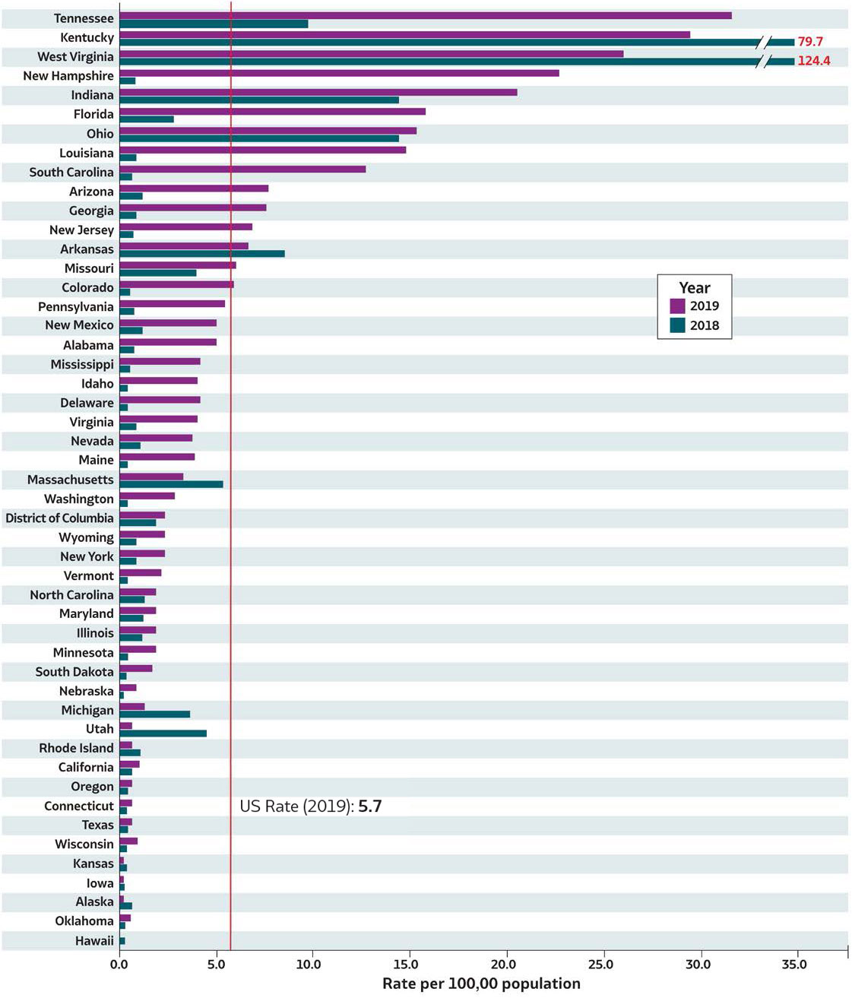
2019 VIRAL HEPATITIS
SURVEILLANCE REPORT
Figure 1.2. Rates* of reported hepatitis A† virus infection, by state or jurisdiction — United States, 2018–2019
Source: CDC, National Notifiable Diseases Surveillance System.
* Rates per 100,000
population.
† Reported cases that met the classification criteria for a confirmed case. For the case definition, see https://ndc.services.cdc.gov/conditions/hepatitis-a-acute/.
Only states with rates for 2018 and 2019 are shown. No hepatitis A cases were reported from Montana and North Dakota in 2018.

