Slide 1
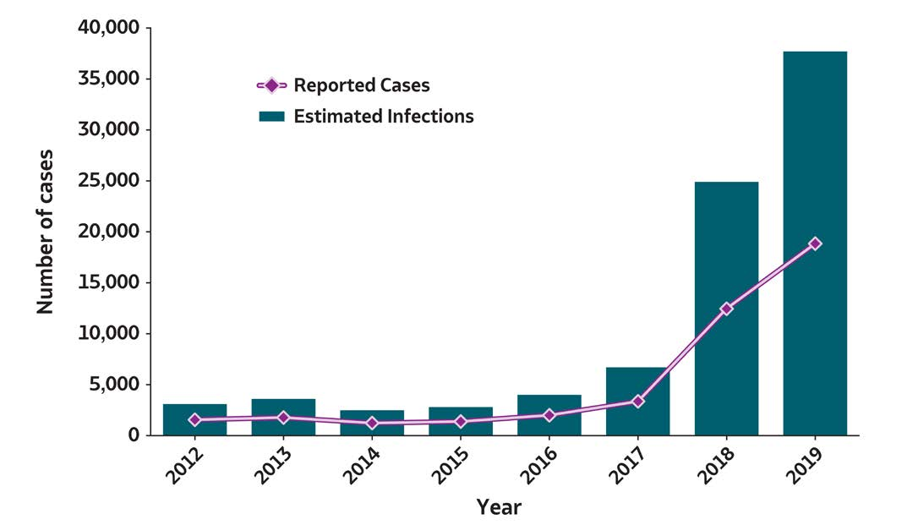
2019 VIRAL HEPATITIS
SURVEILLANCE REPORT
Figure 1.1. Number of reported hepatitis A virus infection cases and estimated infections* — United States, 2012–2019
Hepatitis A | 2012 | 2013 | 2014 | 2015 | 2016 | 2017 | 2018 | 2019
Reported cases | 1,562 | 1,781 | 1,239 | 1,390 | 2,007 | 3,366 | 12,474 | 18,846
Estimated infections | 3,100 | 3,600 | 2,500 | 2,800 | 4,000 | 6,700 | 24,900 | 37,700
Source: CDC, National Notifiable Diseases Surveillance System.
* The number of estimated viral hepatitis infections was determined by multiplying the number of reported cases that met the classification criteria for a confirmed case by a factor that adjusted for underascertainment and underreporting. The 95% bootstrap confidence intervals for the estimated number of infections are displayed in the Appendix.

