Slide 1
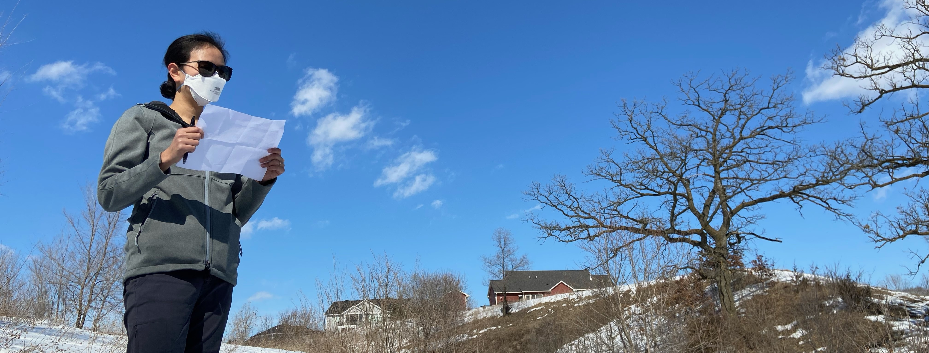

EPIDEMIC INTELLIGENCE SERVICE
CDC’s Disease Detective Training Program

Slide 2
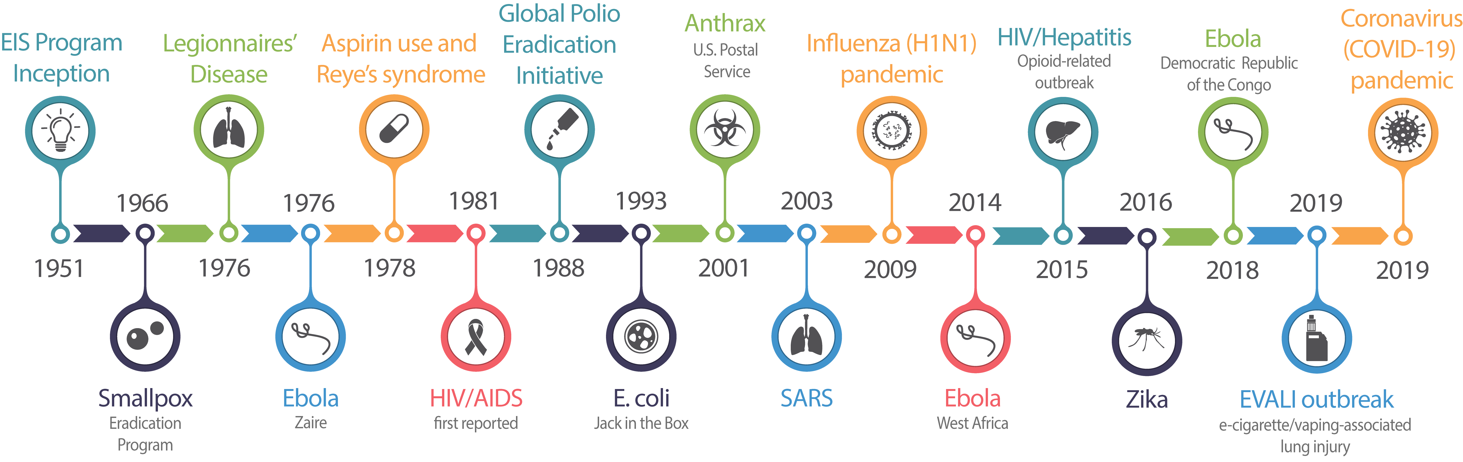
WE WERE THERE
Notes:
Think of a major public health event or emergency. CDC and EIS were there.
Speaker: Walk your audience through one or more events.

Slide 3
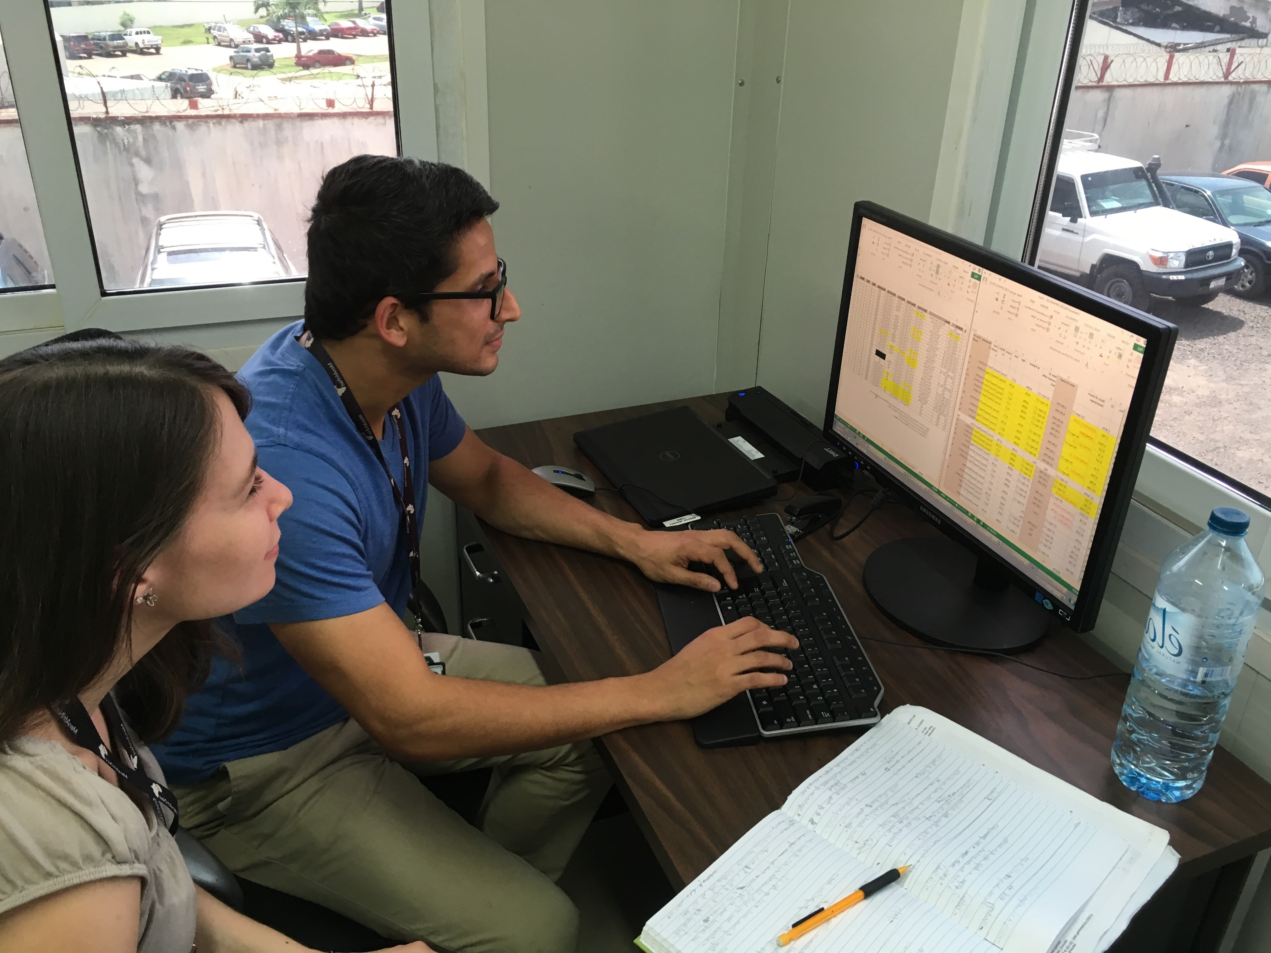
ON THE FRONT LINES
ON THE FRONT LINES
Notes:
Recent example:
As of 5/31/2022:
73% of EIS officers in the 2020 and 2021 classes have supported the COVID-19 Response, including
244 deployments to CDC Emergency Operations Center or field locations
9,163 deployment days
95% (42) of EIS officers assigned to field positions worked on local COVID-19 response activities

Slide 4
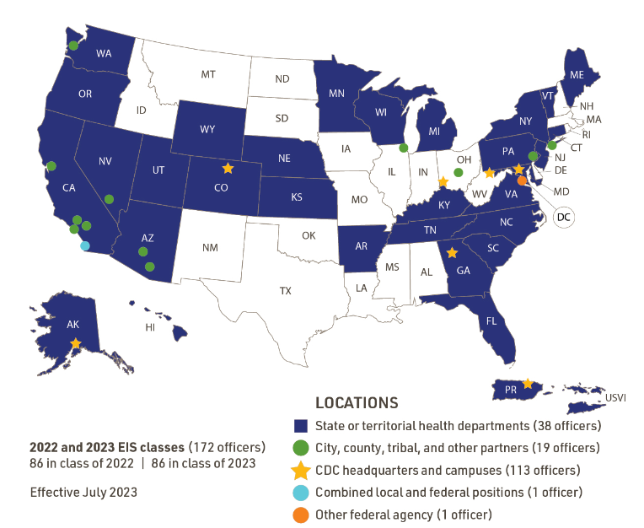
2021 & 2022 EIS Classes
2022 & 2023 EIS Classes
86 in class of 2022 | 86 in class of 2023
Notes:
This map reflects the assigned locations for EIS officers in the classes of 2022 and 2023 across the United States, including CDC headquarters in Atlanta, our field stations in Alaska; Fort Collins, Colorado; the District of Columbia; and the U.S. Virgin Islands. (Assignments are made for EIS officers’ two-year fellowship and do not reflect deployments for Epi-Aids or other emergency response efforts.)
EIS officers placed in the field are embedded in state and local health departments where they work side by side with local public health staff.

Slide 5
EIS OFFICERS ARE
EIS
OFFICERS
ARE . . .
Notes:
CDC’s disease detectives who come from a variety of disciplines with an interest in field experience and a passion for service.
Allied healthcare professionals
Doctoral level scientists (e.g., epidemiologists, microbiologists, psychologists)
Nurses
Physicians
Veterinarians
Pictured: Howard Chiou, MD, PhD, MS, (EIS ‘18) presents an outbreak investigation at the 2019 EIS conference in Atlanta. His is assigned to work in the Los Angeles County Public Health Department.
His education:
MD: Emory University, 2017
PhD(Anthro): Emory University, 2015
MS: Stanford University, 2006
BA: Stanford University, 2006

Slide 6
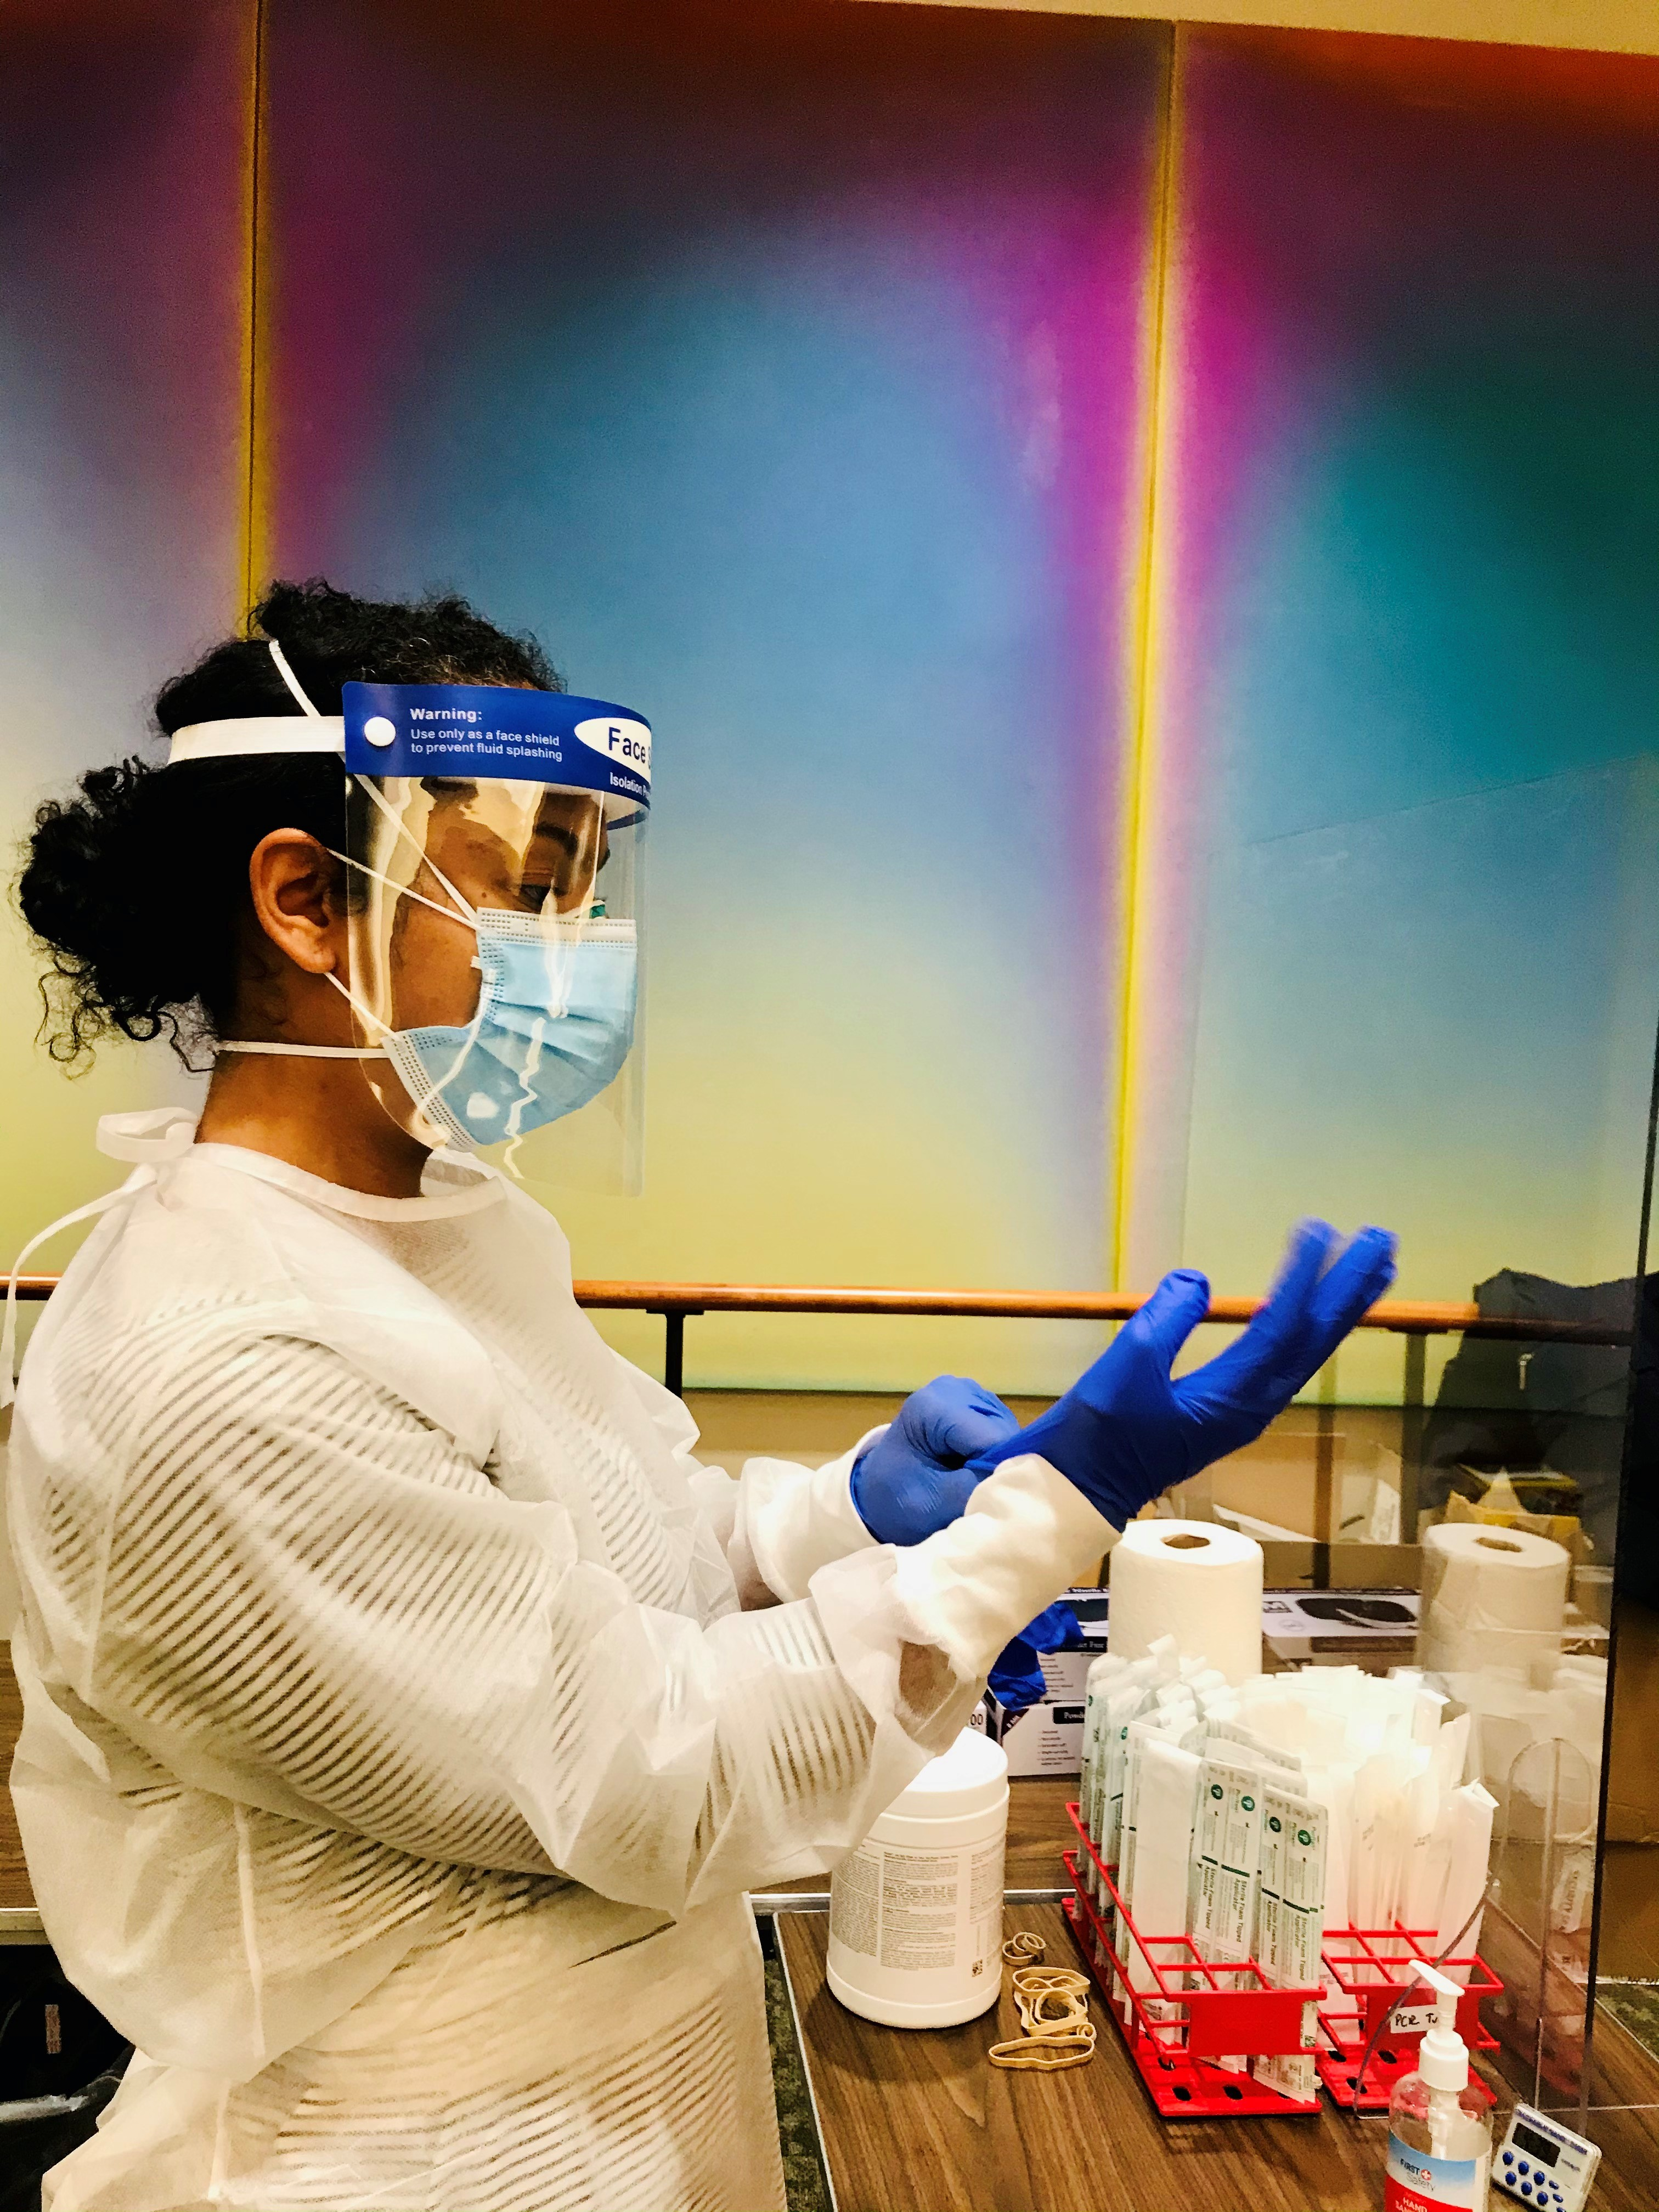
WHY EIS?
Notes:
The EIS program is the world’s longest-running field epidemiology training program.
EIS officers are employed by CDC where they are supervised and mentored by epidemiologists and other scientists recognized as subject matter experts in their respective fields.
In this photo, EIS officer Miriam Van Dyke (EIS 2020) helps collect swab samples for a validation study of a rapid antigen test for COVID-19.

Slide 7
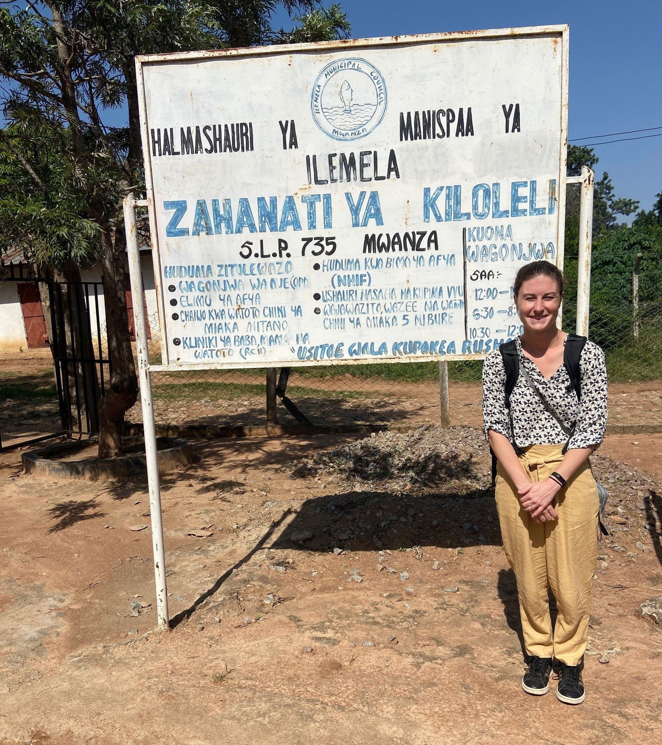
THERE’S NOTHING LIKE IT
Notes:
EIS provides officers with:
2 years on-the-job learning and field work
You are guided by CDC experts and EIS alumni
Unparalleled opportunities
Work as part of interdisciplinary teams to detect and respond to new and ongoing public health threats.
Like Kelsey Sumner (EIS Class of 2021) pictured here in Mwanza, Tanzania during a poliovirus response in June 2022.
As an EIS officer, you’ll…
Have opportunities to work at CDC and state/local health departments
Be part of interdisciplinary teams
Contribute as part of a service and learning program

Slide 8
PRESENTERS pictures here
Add Your Photo Here
Add your name and EIS story here
Notes:
Have your own EIS story? Build this slide to reflect your experiences.

Slide 9
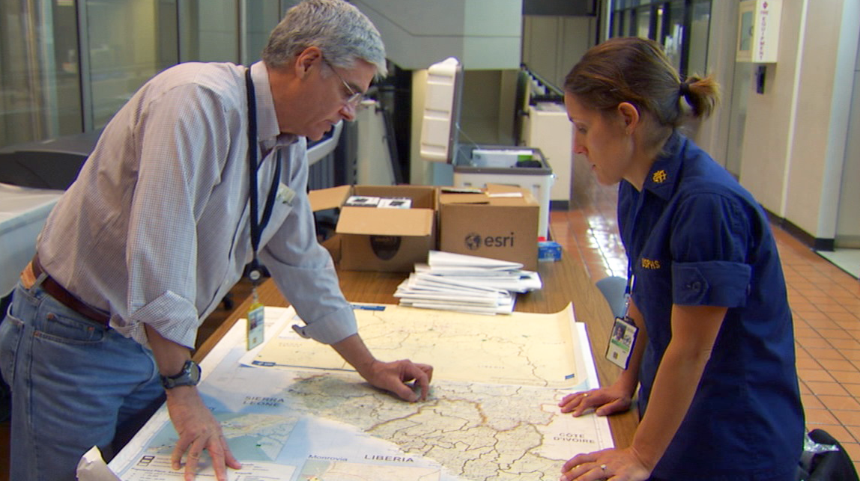
WHERE COULD EIS TAKE YOU?
Notes:
EIS is a gateway to a strong foundation and a successful career in public health.

Slide 10

More than 40%
900+
peer-reviewed scientific publications
authored by EIS officers from classes of 2015-2020

Slide 11

More than 95%
97%
of recent EIS graduates continue
in public health-related positions
Notes:
As of August 2022

Slide 12
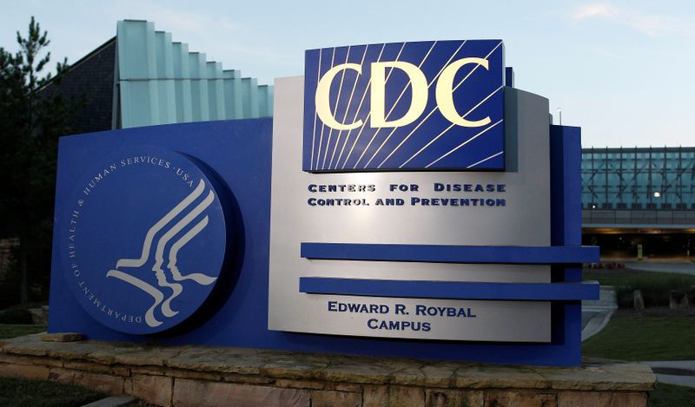
4 of the last 11
4 of the last 12
CDC Directors are EIS alumni

Slide 13
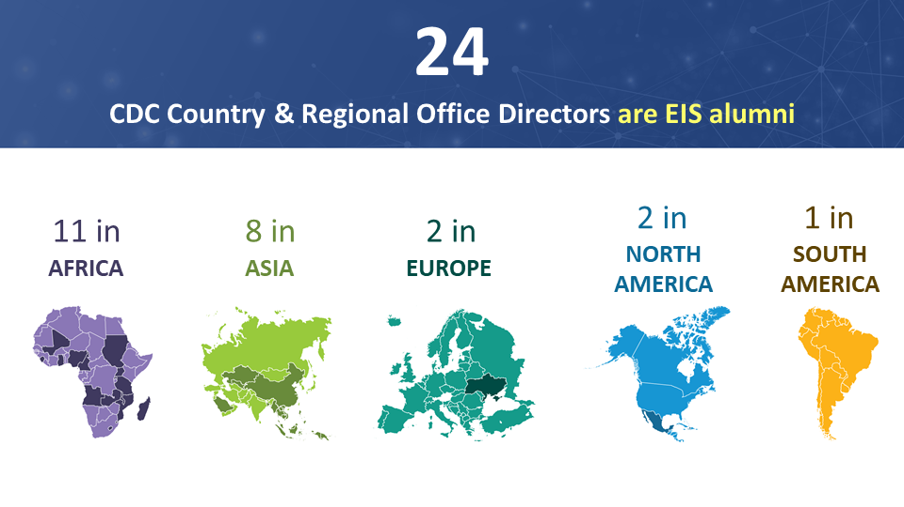
24 CDC Country & Regional Office Directors are EIS Alumni
Notes:
As of August 2022

Slide 14
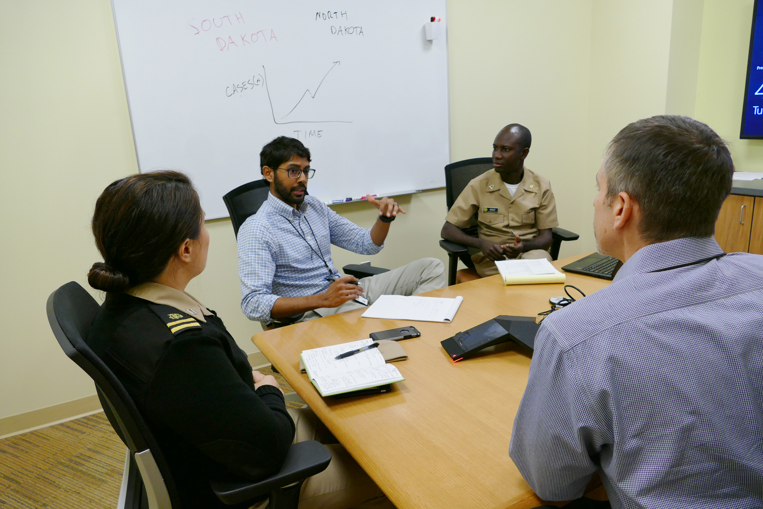
Ready to make a difference?
Notes:
Are you ready to join EIS and make a difference?
Go to our website and check eligibility
Apply in the spring
To hear about the experiences of an EIS officer, check out their stories on the EIS website.

Slide 15
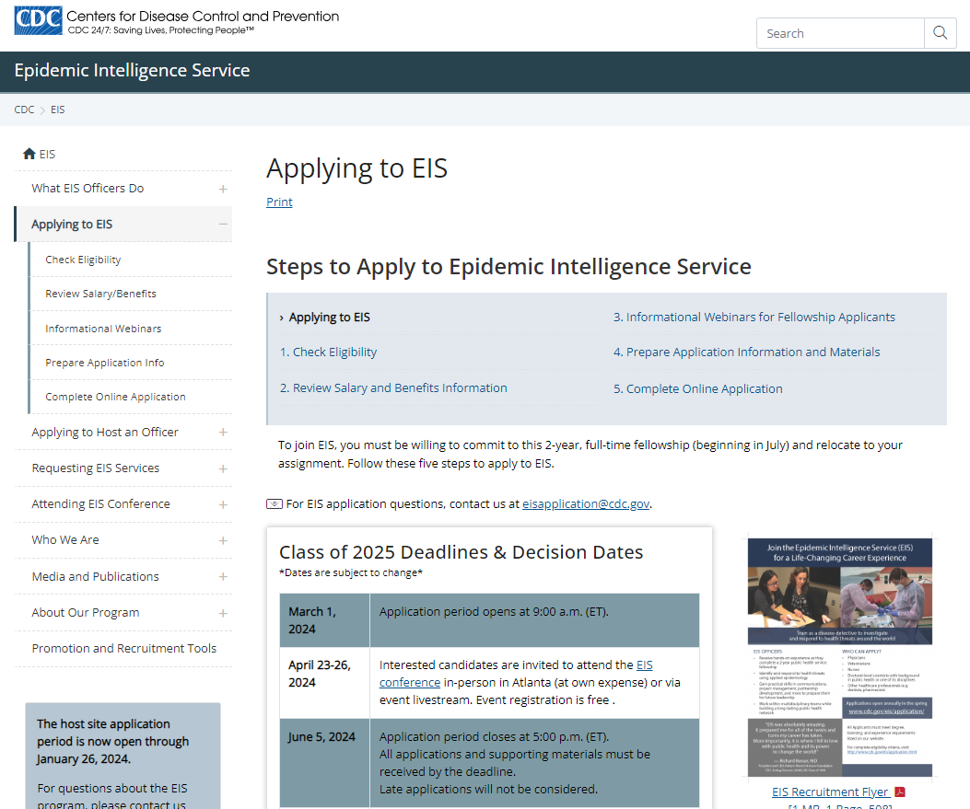
How to Apply
HOW TO
APPLY
cdc.gov/eis
SPRING 2024
Notes:
Applications for the EIS Class of 2025 will open on March 1, 2024.

Slide 16
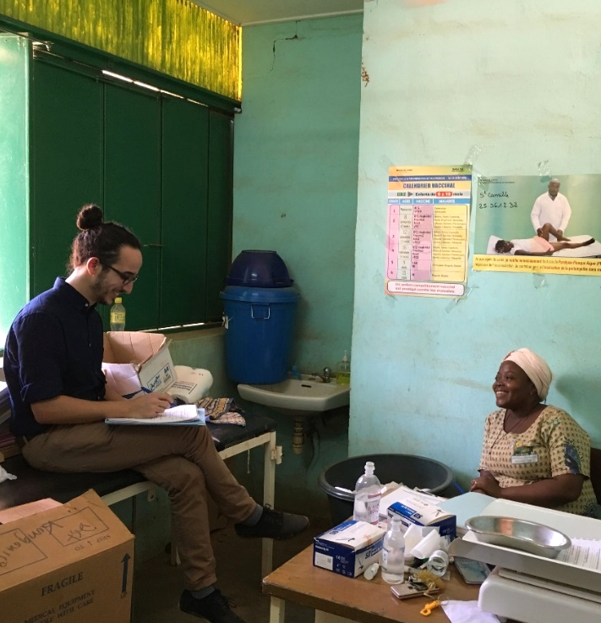
Learn More
LEARN
MORE
cdc.gov/eis
cdc.gov/fellowships
Notes:
Pictured here is Dr. Amen Ben Hamida (EIS ‘17) from CDC's Emergency Response and Recovery Branch (ERRB) traveled to Burkina Faso on an International Epi-Aid to strengthen severe acute respiratory infection (SARI) sentinel surveillance ahead of the influenza season. Here, Dr. Ben Hamida interviews a Burkinabe health care worker to better understand how local staff use a standardized case definition to decide whether a case is "SARI" or "not SARI."
To learn more about EIS and become a Disease Detective like Amen, check our website and you can email us at the address provided.
Thank you for your time.

